Slide 1
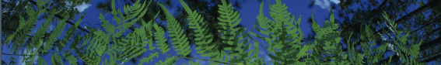

Climate Processing
University of Florida

Slide 2
What data are we using?

Slide 3
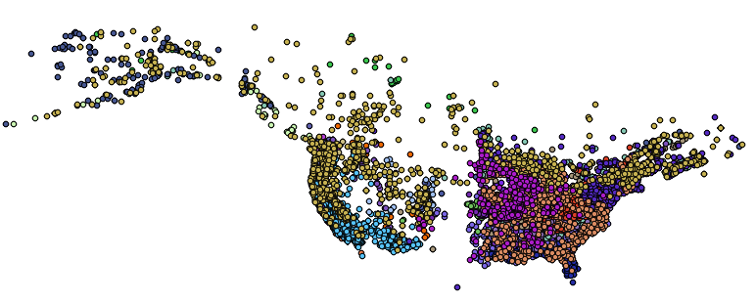
What data are we using?
1. Georeferenced occurrence records

Slide 4
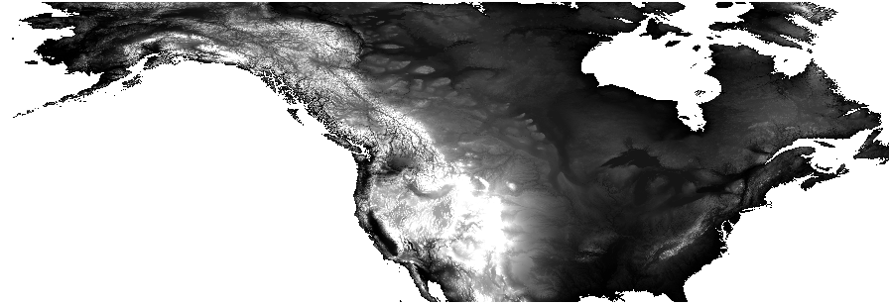
What data are we using?
2. Gridded abiotic data layers

Slide 5
Abiotic data layers
What kinds?
Temperature, precipitation, soil, vegetation, land use
Where?
Local, USA, North America, Global
When?
Past, current, future

Slide 6
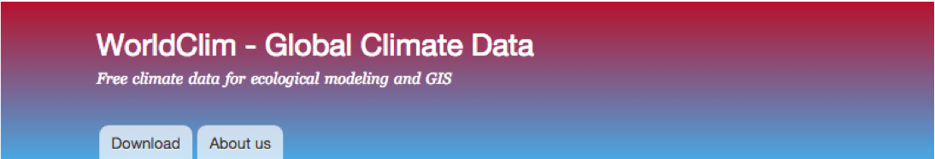
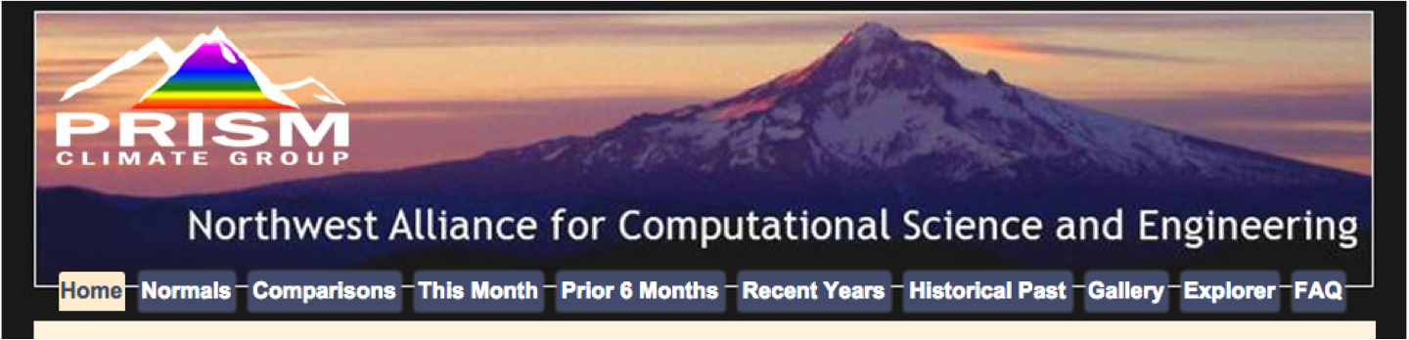
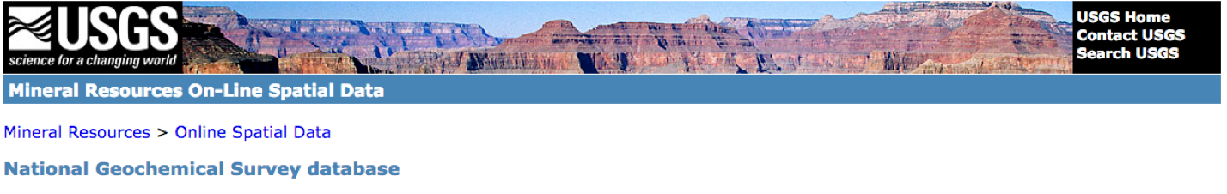
Data layer sources
WorldClim
PRISM
Unified North American Soil Map
USGS
EPA
NOAA
PMIP
AquaMaps

Slide 7
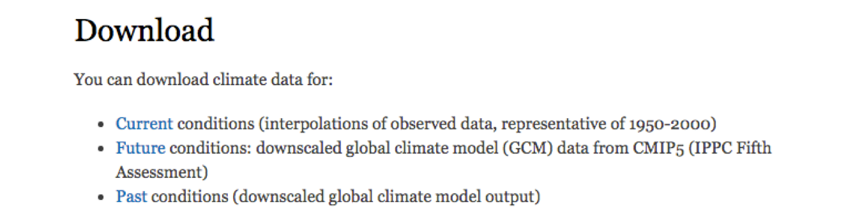
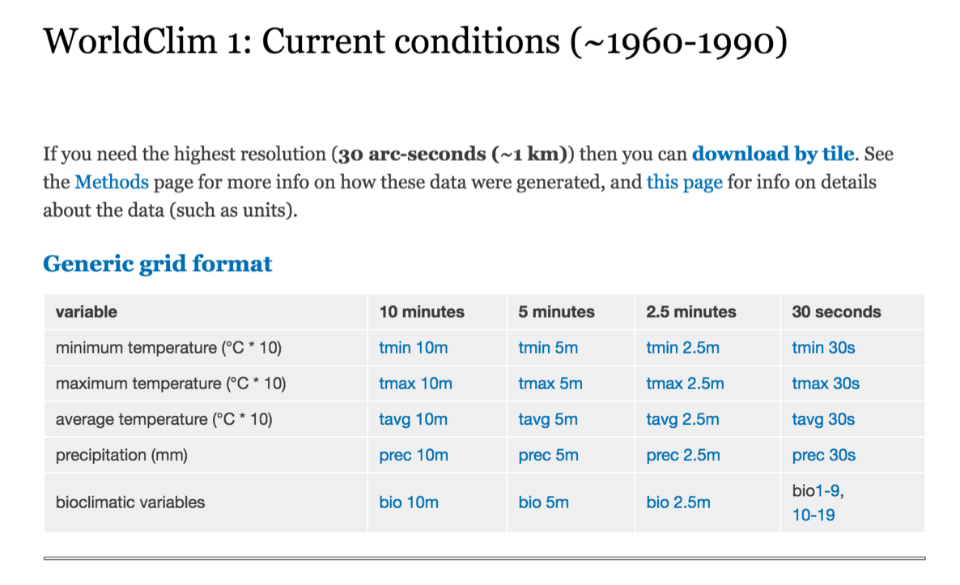
WorldClim
Global climate data
Multiple resolutions
19 Bioclimatic variables derived from monthly temperature and rainfall values
Current conditions:
averaged over past 50 years
Future conditions:
climate projections from a number of global climate models with different greenhouse gas concentration trajectories
Past conditions:
Mid-Holocene, Last Glacial Maximum, Last Inter-Glacial
WorldClim 2 now available, has same 19 + new variable layers
www.worldclim.org

Slide 8
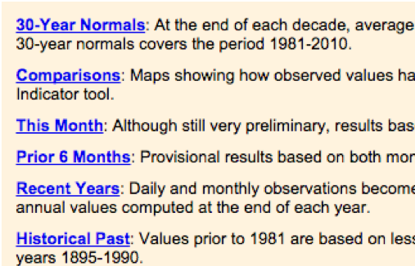
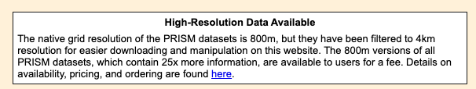
PRISM
Climate data for the US
More precise than WorldClim
Larger files, more work
Data available from 1895 to present
Lots of data and tools to explore
www.prism.oregonstate.edu

Slide 9
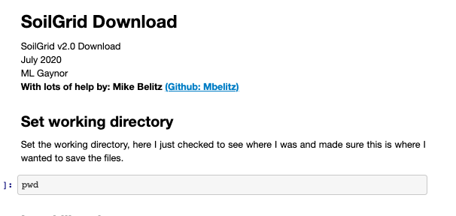
Soil Sources
SoilGrids2.0: https://soilgrids.org
Entire globe
Eight characteristics of topsoil and subsoil
2.5 arc second resolution
mgaynor1/long-winded-scripts/SoilGridDownload/

Slide 10
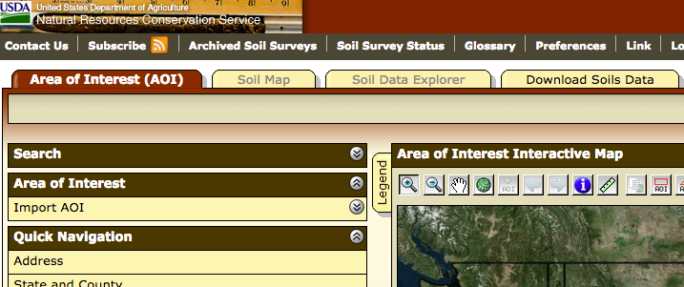
Soil Sources
SoilGrids2.0: https://soilgrids.org
Entire globe
Eight characteristics of topsoil and subsoil
2.5 arc second resolution
USGS: http://websoilsurvey.sc.egov.usda.gov/App/HomePage.htm
US only
Need to define area of interest
Big files and tough to get large areas

Slide 11
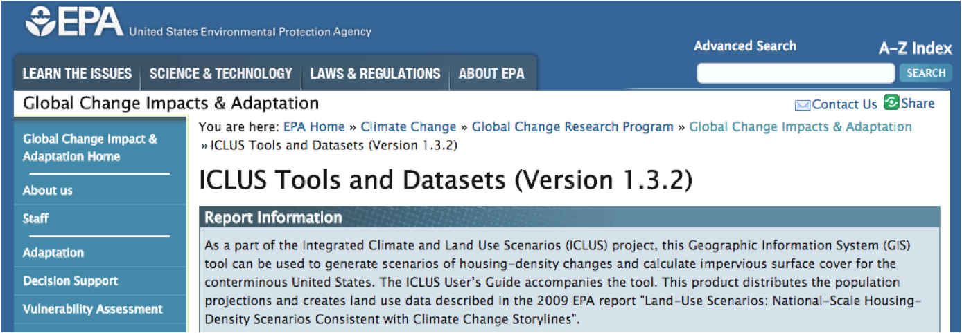
EPA
http://cfpub.epa.gov/ncea/global/recordisplay.cfm?deid=257306
Land use
County population projections
Housing density projections
Percent impervious surface projections
Notes:
amount of pavement

Slide 12
Other resources
Paleoclimate data
NOAA (NCEI):https://www.ncdc.noaa.gov/data-access/paleoclimatology-data/datasets
PMIP: https://pmip.lsce.ipsl.fr/
PaleoClim: http://paleoclim.org/
Aquatic Environments
AquaMaps: http://www.aquamaps.org/main/envt_data.php

Slide 13
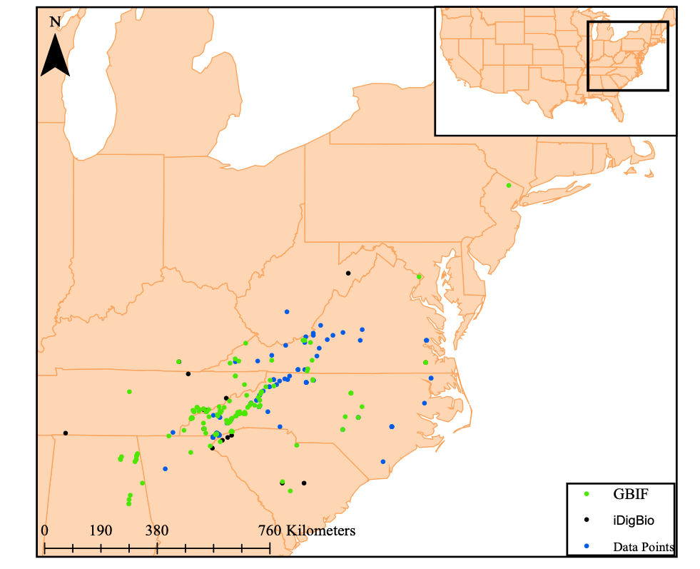
Cleaning Climatic Layers

Slide 14
Layer Processing
Need layers in ASCII format
Clip layers to fit your desired range
Convex hull + Buffer

Slide 15
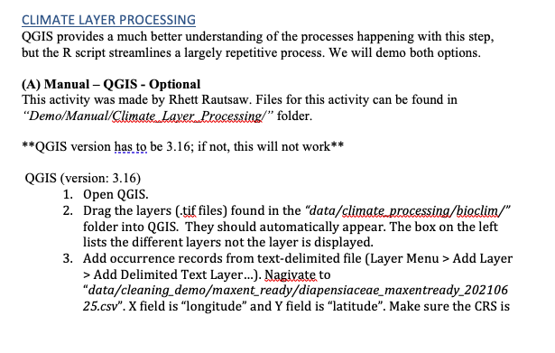
Layer Processing
For an intro to QGIS:
Github: RhettRautsaw/GIS_Tutorial

Slide 16
Layer Processing
Need layers in ASCII format
Clip layers to fit your desired range
Dynamic alpha hull
+ 80th quartile buffer
03_ClimateProcessing.R

Slide 17
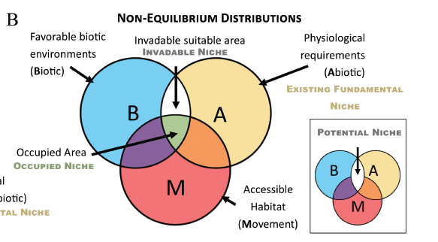
Accessible area can be defined based on:
species ecology
dispersal ability
geographical barriers
Brown and Carnaval. 2019. A tale of two niche: methods, concepts, and evolution. Frontiers of Biogeography.

Slide 18
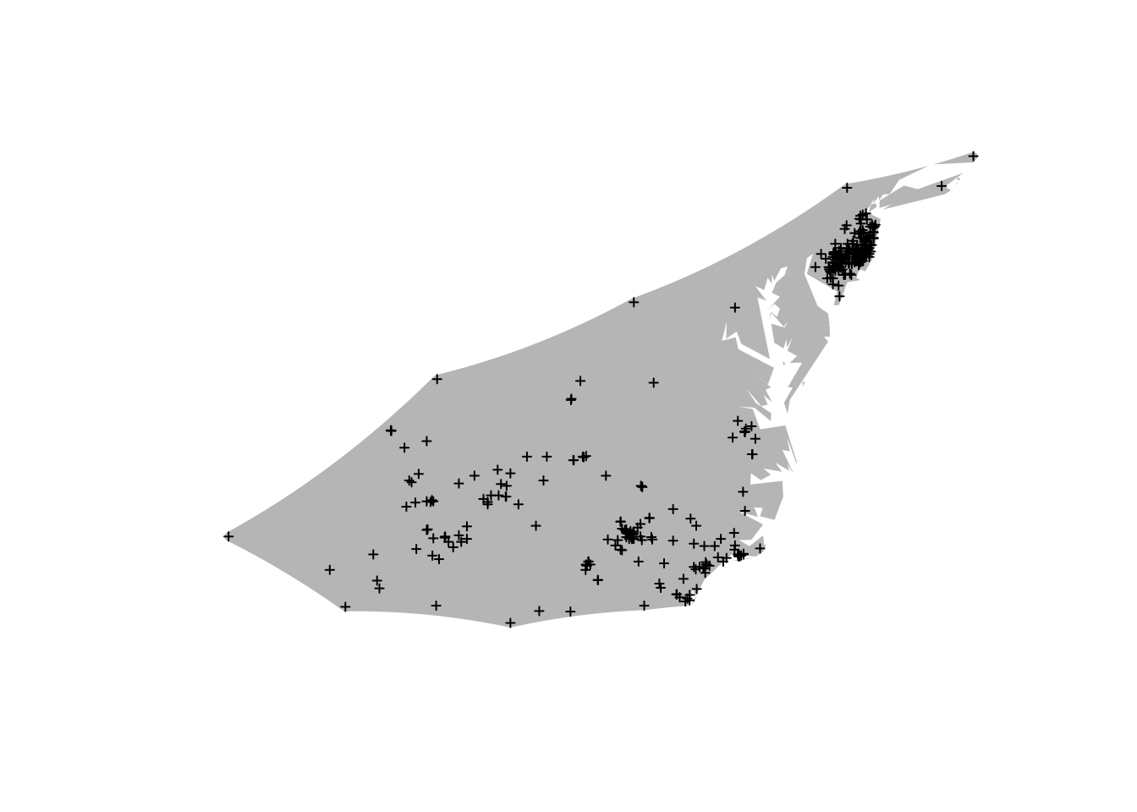
Accessible area can be defined based on:
species ecology
dispersal ability
geographical barriers
alpha-hull: piecewise series of linear simple curves
convex-hull is a type of alpha-hull

Slide 19
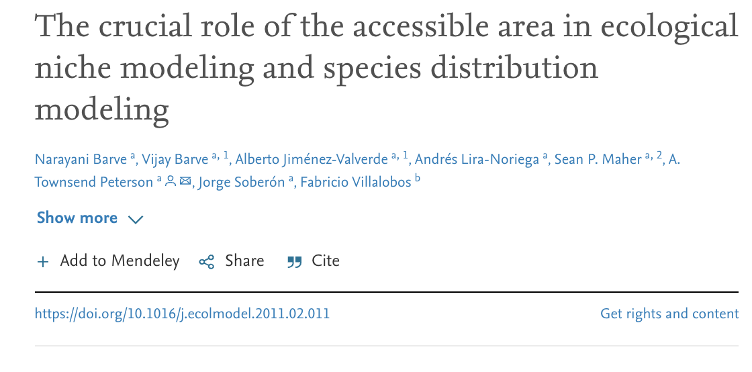
More area, AUC increased.
higher model significance as buffer size increased

Slide 20
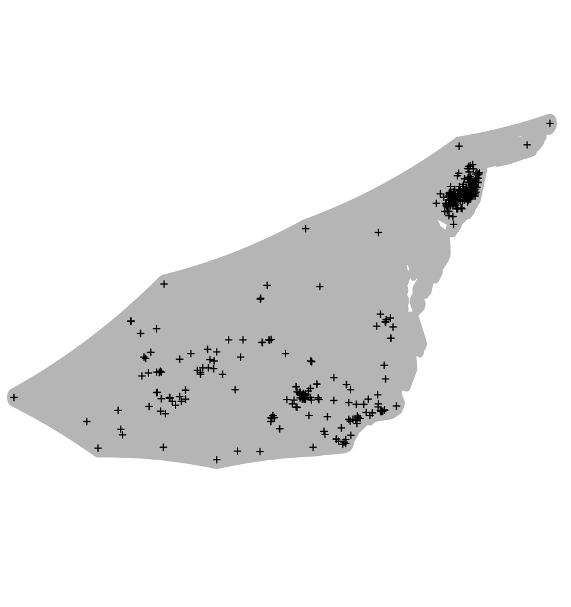
alpha-hull
alpha-hull + buffer

Slide 21
Layer Processing
Need layers in ASCII format
Clip layers to fit your desired range
Dynamic alpha hull
+ 80th quartile buffer
Remove layers with collinearity based on variable inflation factor and permutation importance.
03_ClimateProcessing.R

Slide 22
PCA | PC1 + PC2 = ~95% | Reduces variables to axis
Pearson correlation | Removes variables > |0.80| | Removes correlated variables
Variable Inflation Factor | Removes variables > 10 | Removes collinear variables

Slide 23
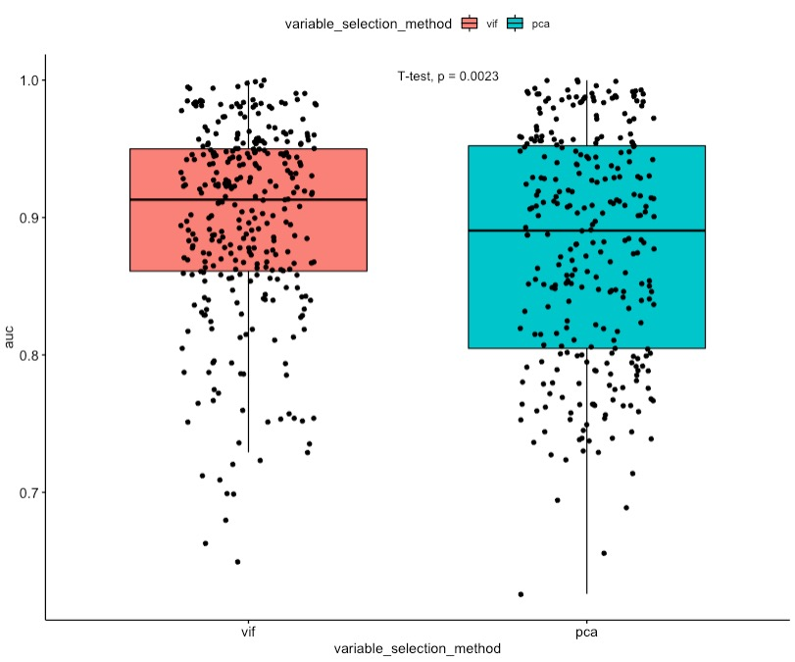
PCA vs VIF with permutation
AUC was significantly higher in models generated using the VIF method
Based on 109 species in the subfamily Crotalinae (Viperidae)
PCA with 75% collinearity cutoff, each variable contribution had to be >5%.
VIF < 10, permutation importance > 1%
Rautsaw, R. et al. 2022. In prep.

Slide 24
Layer Processing
Need layers in ASCII format
Clip layers to fit your desired range
Dynamic alpha hull
+ 80th quartile buffer
Remove layers with collinearity based on variable inflation factor and permutation importance.
Define shared projection layers and training layers.
03_ClimateProcessing.R

Slide 25
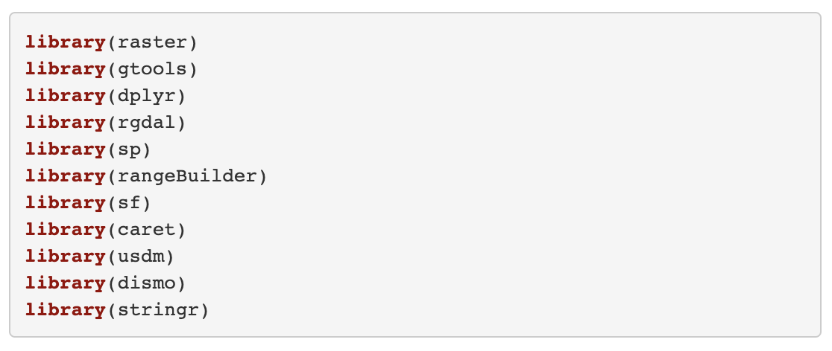
Load Packages

Slide 26
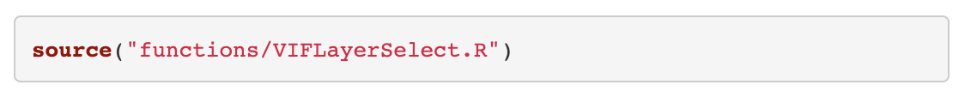
Load Functions
These functions are modified from mbelitz/Odo_SDM_Rproj (GitHub)

Slide 27
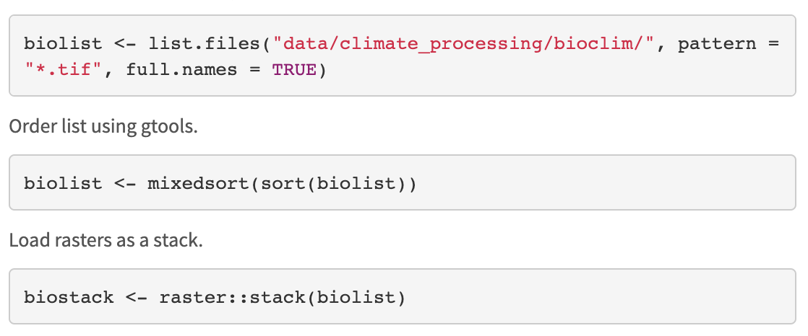
Load bioclim layers

Slide 28
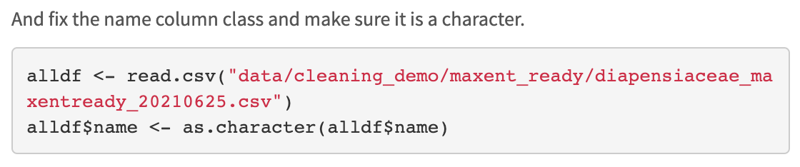
Load occurrence records

Slide 29
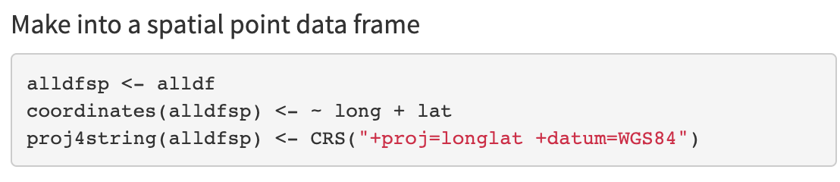
Define extent
Make into spatial point data frame by defining coordinates, datum, and projection

Slide 30
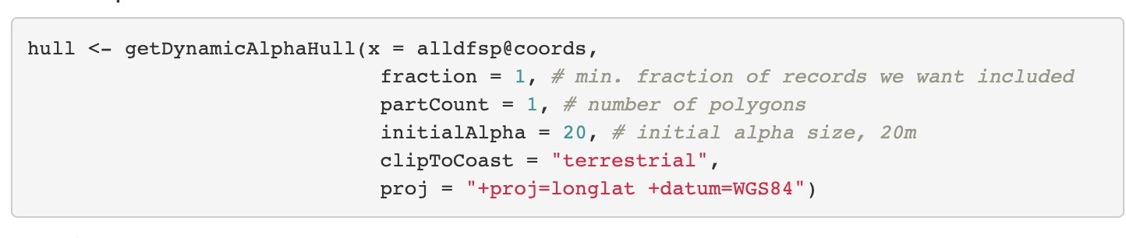
Define extent

Slide 31
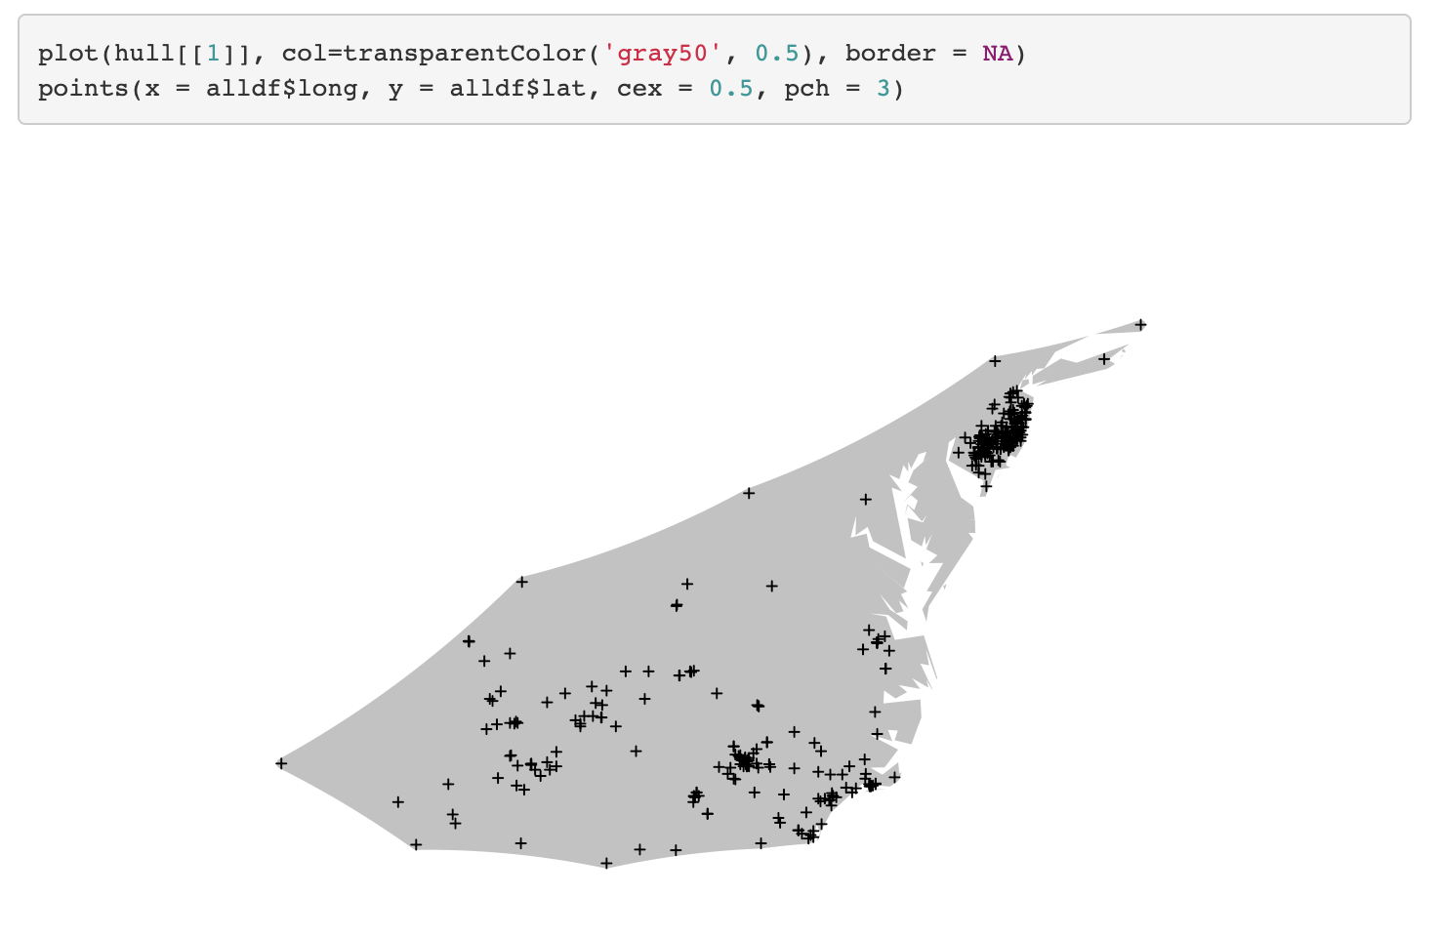
Define extent

Slide 32
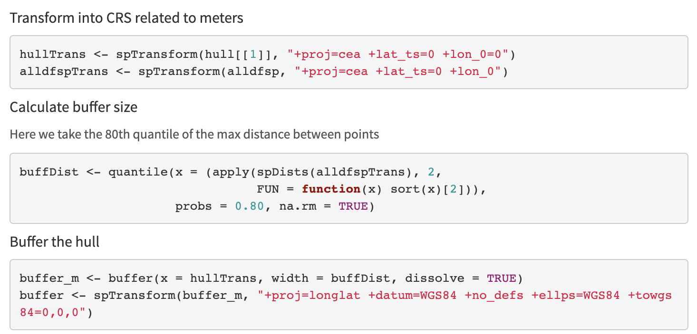
Define extent

Slide 33
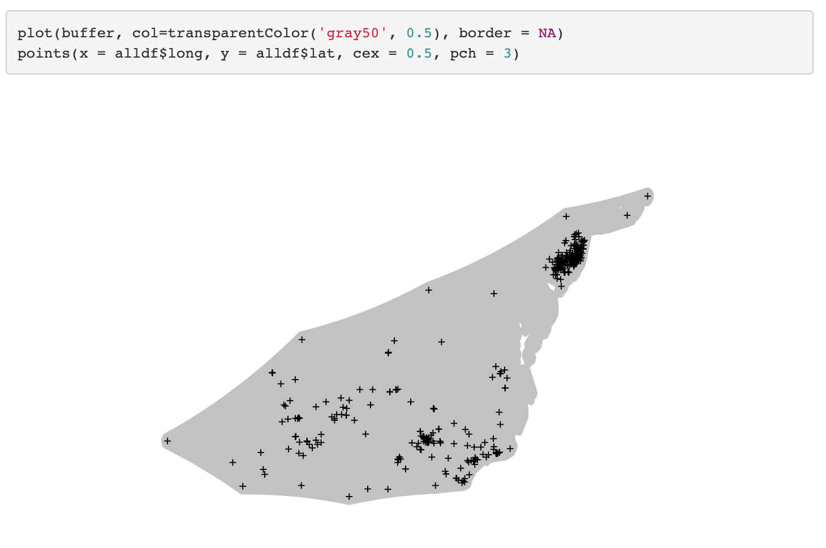
Define extent

Slide 34
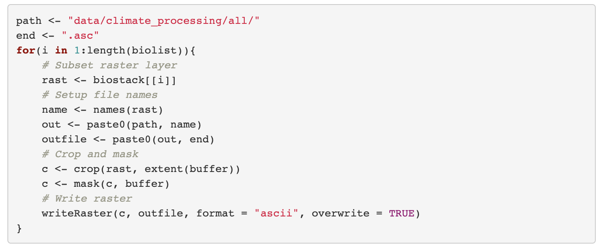
Mask and Crop Layers

Slide 35
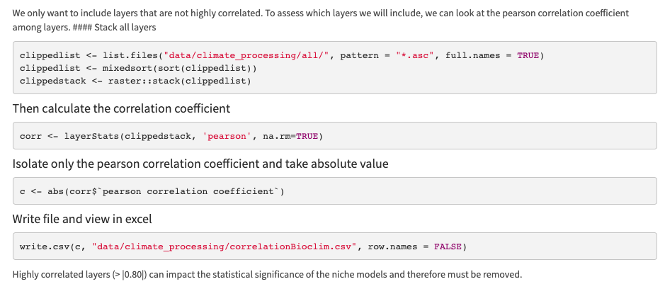
Select layers

Slide 36
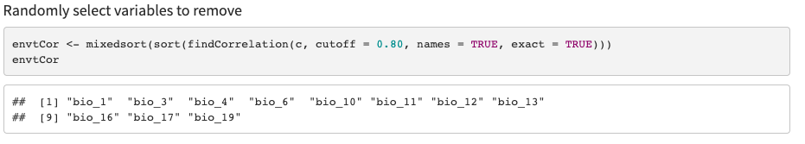
Select layers

Slide 37
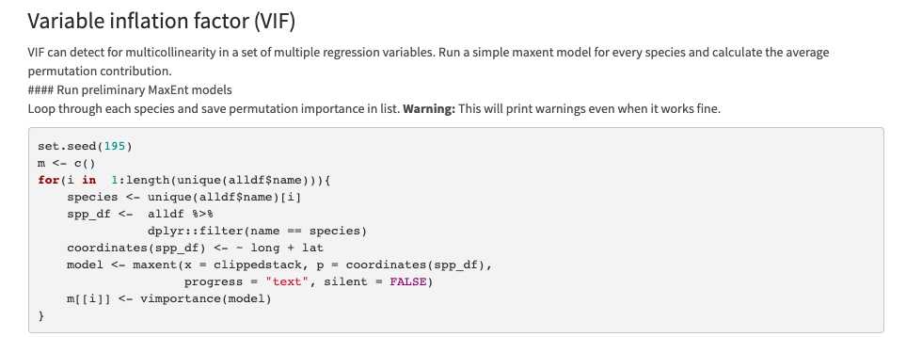
Select layers
This may take a while!

Slide 38
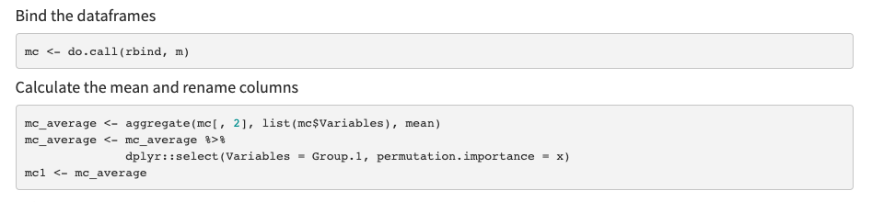
Select layers

Slide 39
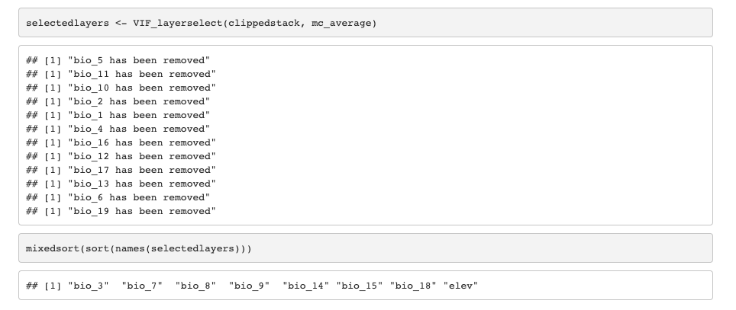
Select layers

Slide 40
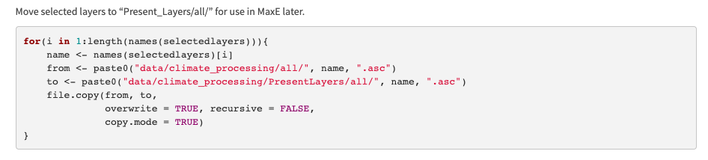
Select layers

Slide 41
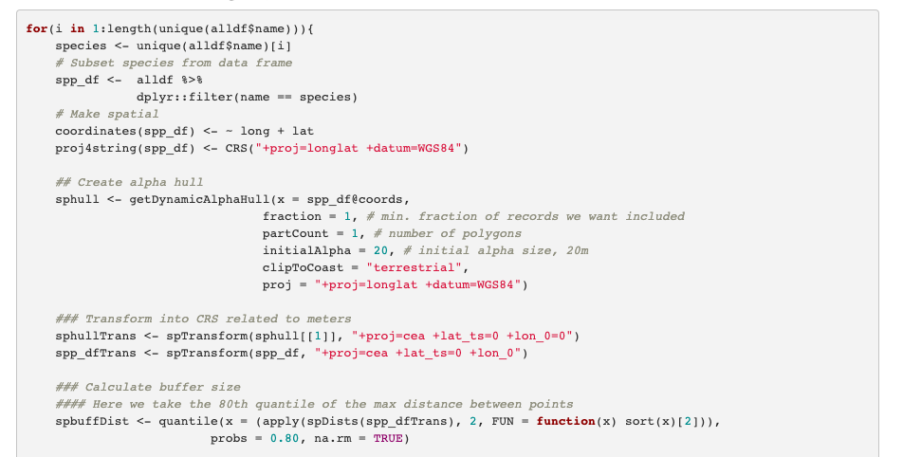
Warning: Takes > 1.30 mins to run
Create Species Training Layers

Slide 42
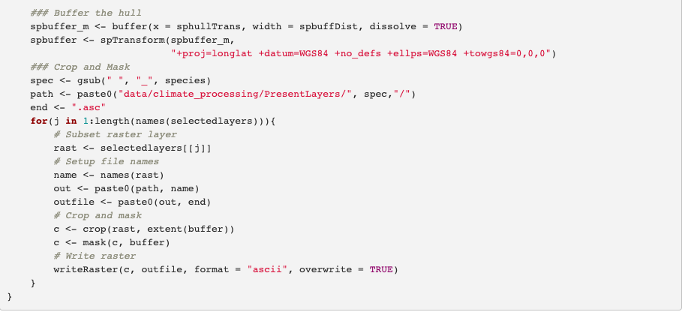
Warning: Takes > 1.30 mins to run
Create Species Training Layers

